Slide 1
An intelligent telephone interceptor for UK Landlines
Meng Kiang SEAH
Notes:
Hi my name is Meng, and this is my FYP presentation! It’s on “An Intelligent Telephone Interceptor for UK Landlines.” Let’s get started!

Slide 2
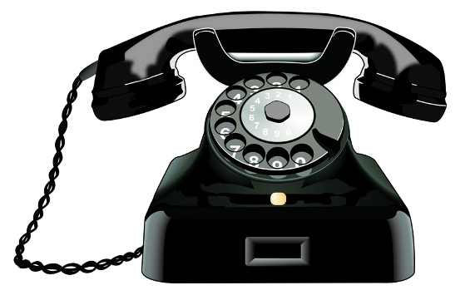
Contents
Introduction and Background
Requirements
Design & Implementation
Testing & Results
Demo
Conclusion
https://www.kullabs.com/img/note_images/XEczPuDvZvyDWvjl.jpg
Notes:
So, I’ll briefly go through what I’ll be covering today. First, a little introduction and background to contextualise the entire project. Then, a run through of some of the requirements, followed by parts of the Design process that are interesting to note. Then, a little more about how I implemented the whole thing, followed by some testing and results. Finally, a short little video demo, and then a few evaluation points to cover.

Slide 3

Introduction & BACKGROUND
Unwanted calls, an annoyance, and a danger.
£113 million, £1 billion [Guardian, 4]
Remove, filter, reduce?
Many types! Investment, pension, bank, computer help, compensation, anti-scam.

Slide 4

Requirements
Audience
Setup
Location
Implementation
Connections - SIP
Identification - Asterisk
User Interface
http://cdn2.ubergizmo.com/wp-content/uploads/2011/06/brain-expansion-blue.jpg

Slide 5
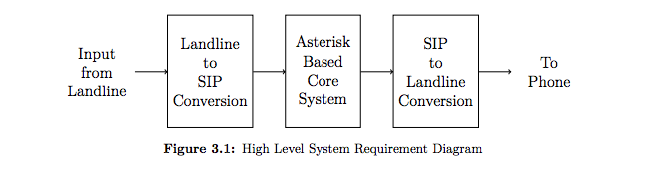
Requirements Diagram

Slide 6
Design – Identification and filtration
Types of Callers
Classification Methods
Robot
Human
Unknown
Dangerous
Legitimate
Known
Reverse Turing test
Weakly Secret Information
Speech Content Analysis

Slide 7
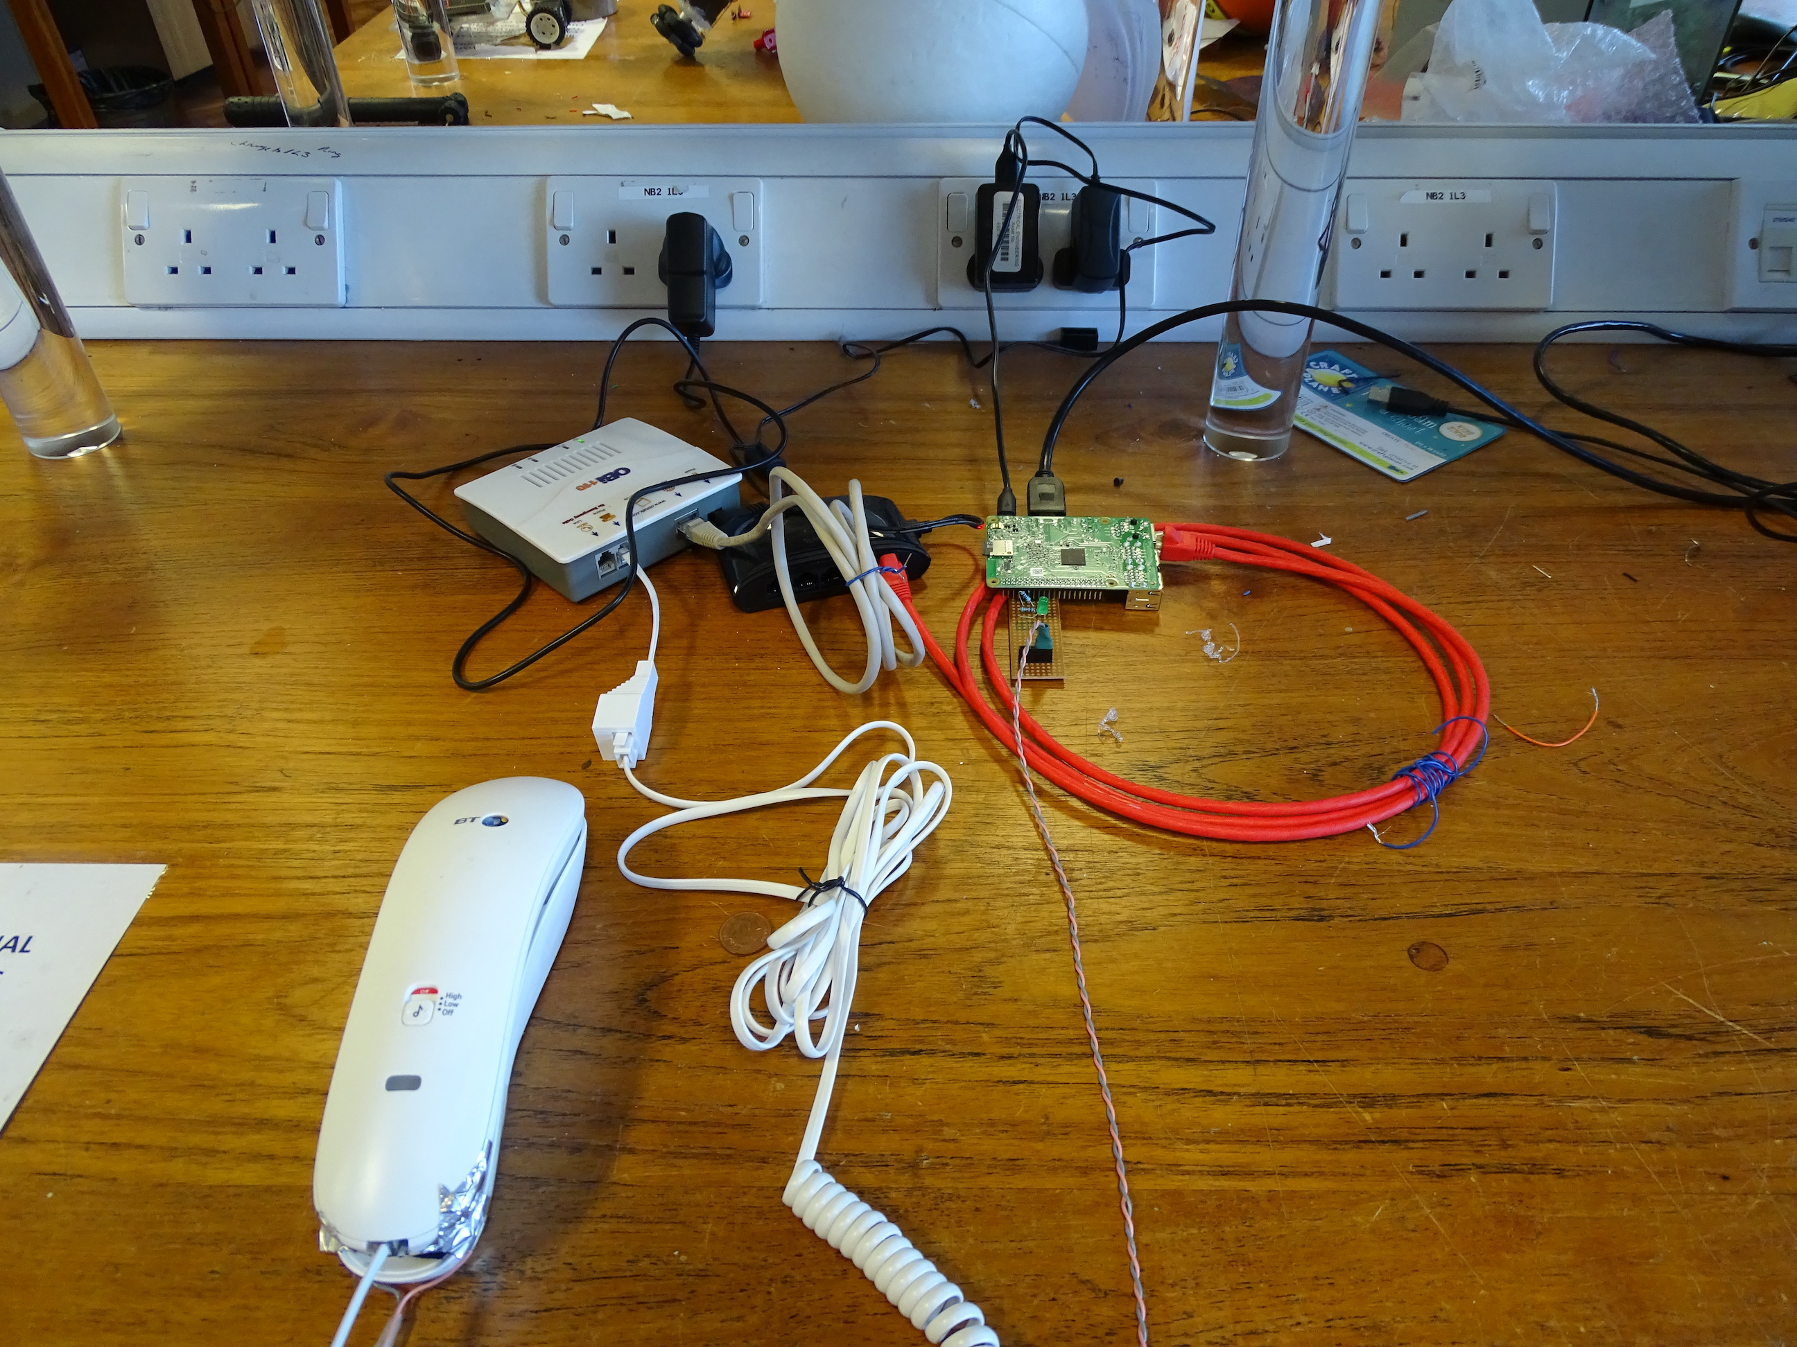
Implementation
Pi: Core System & DHCP
Obi110: Landline-SIP & vice-versa
IVR: Interactive Voice Response
Welcome Message
Goodbye Message
Secret Code
Call Recording

Slide 8
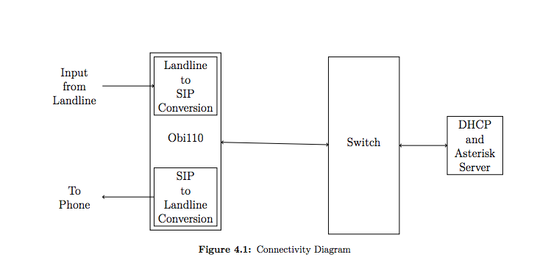
IMPLEMENTATION - Connectivity Diagram

Slide 9
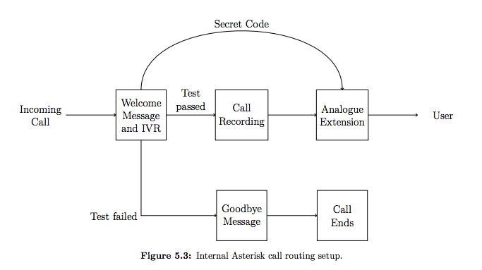
Call Routing

Slide 10
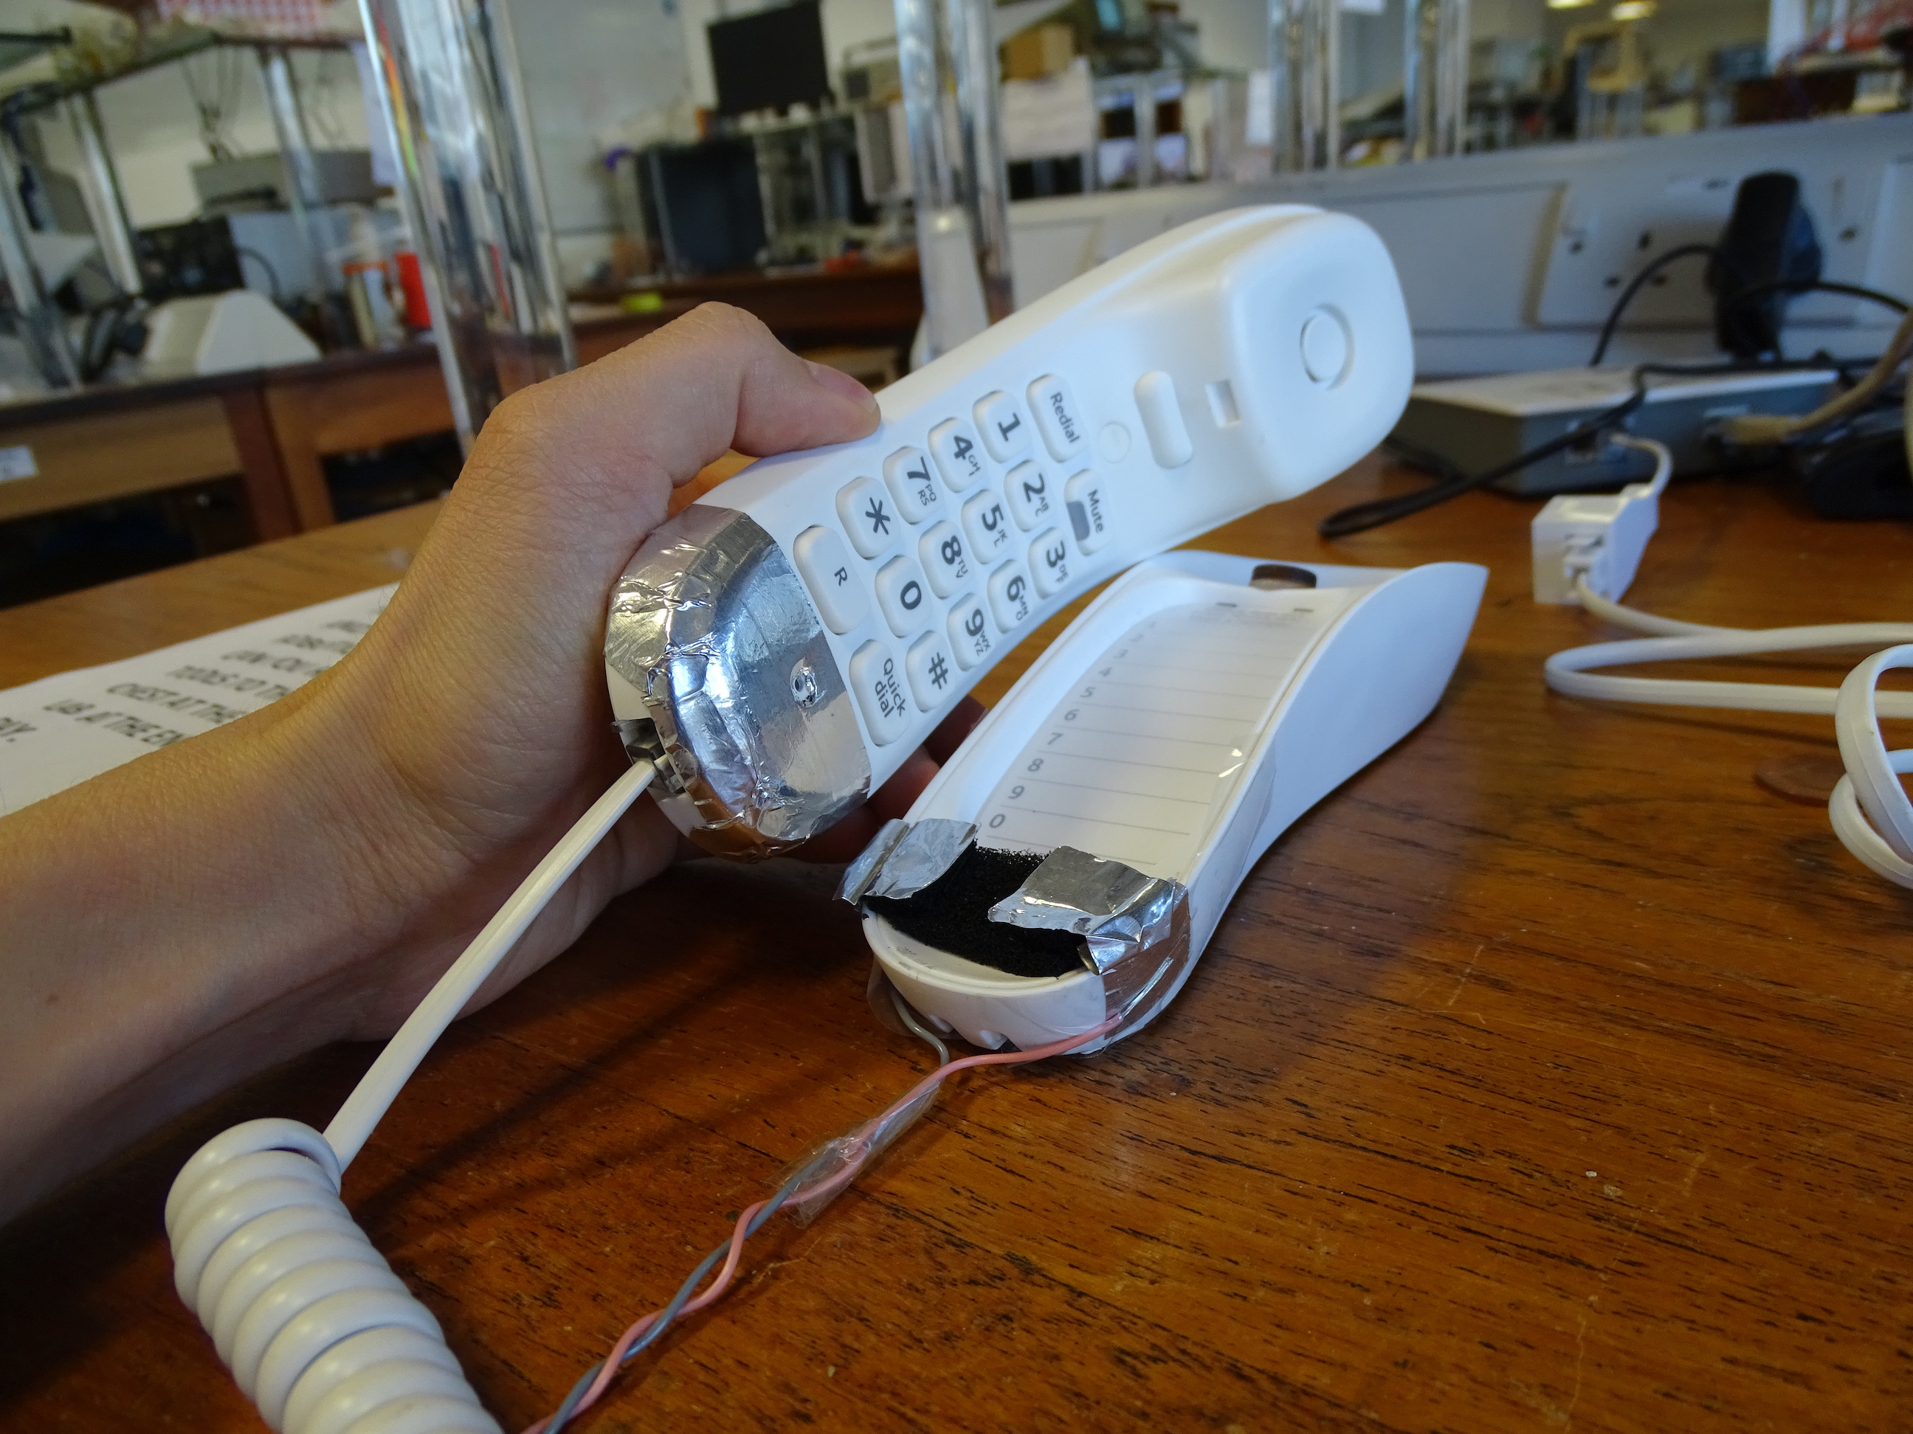
Speech Content Analysis
Call Recording
Extraction of recording data after pickup
Switch Used
Sending to Bing Speech Recognition
Running call through function to obtain metric

Slide 11
Speech content analysis
Keywords
Based on the types of common scams
Definitely Dangerous, Maybe Dangerous
Metric ? Low, Medium, High Risk
A - Dangerous | B - Maybe | Classification
0 | 0 | Low
> 0 | 0 | High
0 | > 0 | Medium
> 0 | > 0 | B > A: Medium A > B: High

Slide 12
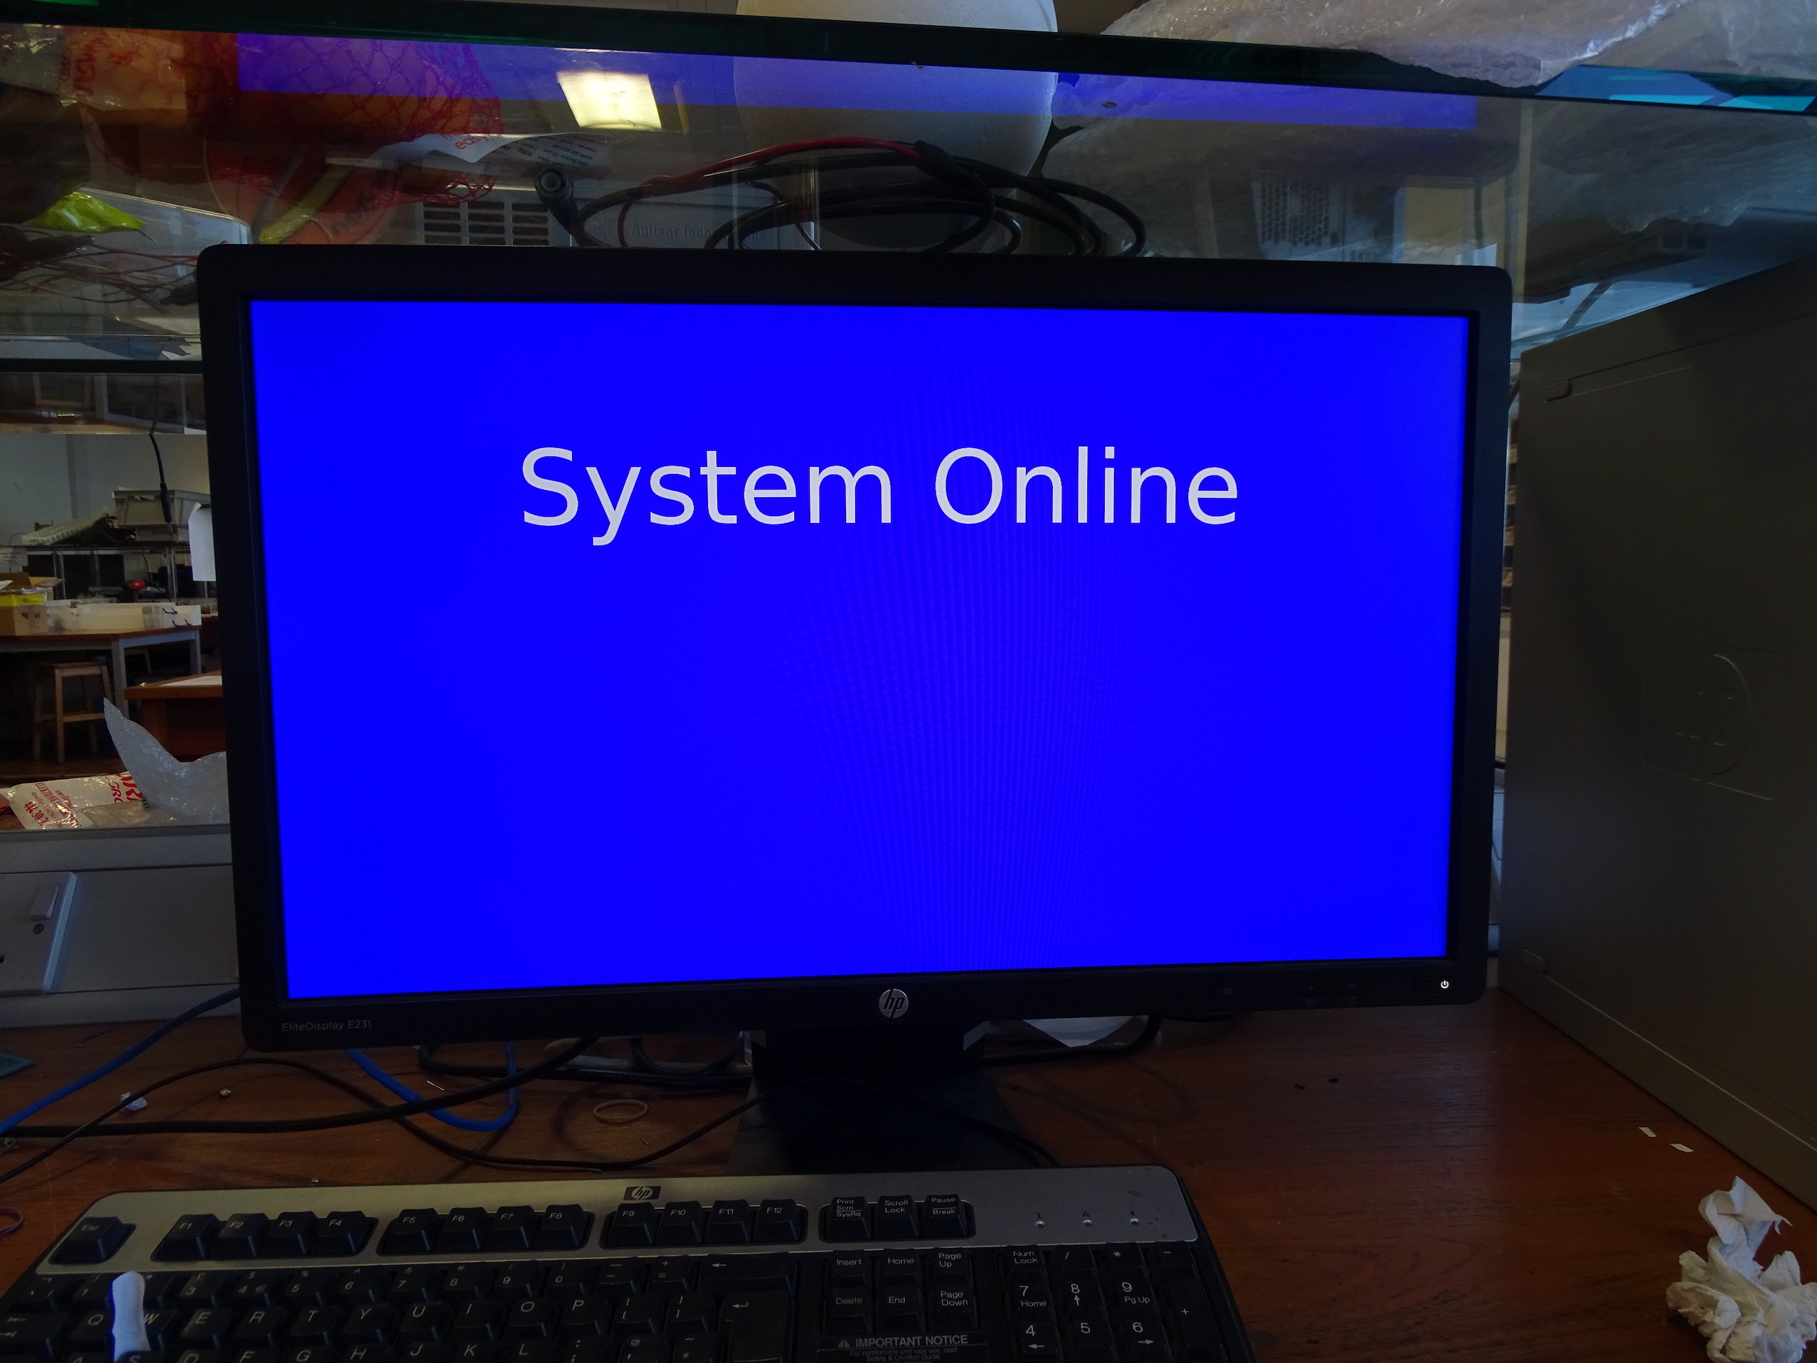
Display and Output
Python was used for the call analysis
A webpage
Python Flask server, Jinja2 template.
Bash script: runs Python script, then launches Chromium in kiosk mode

Slide 13

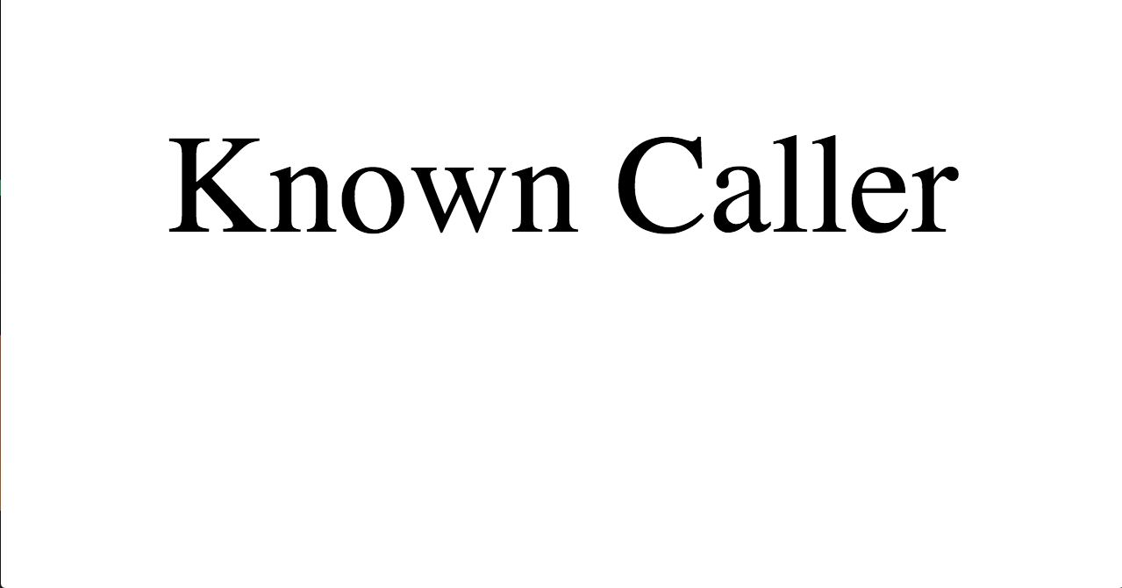
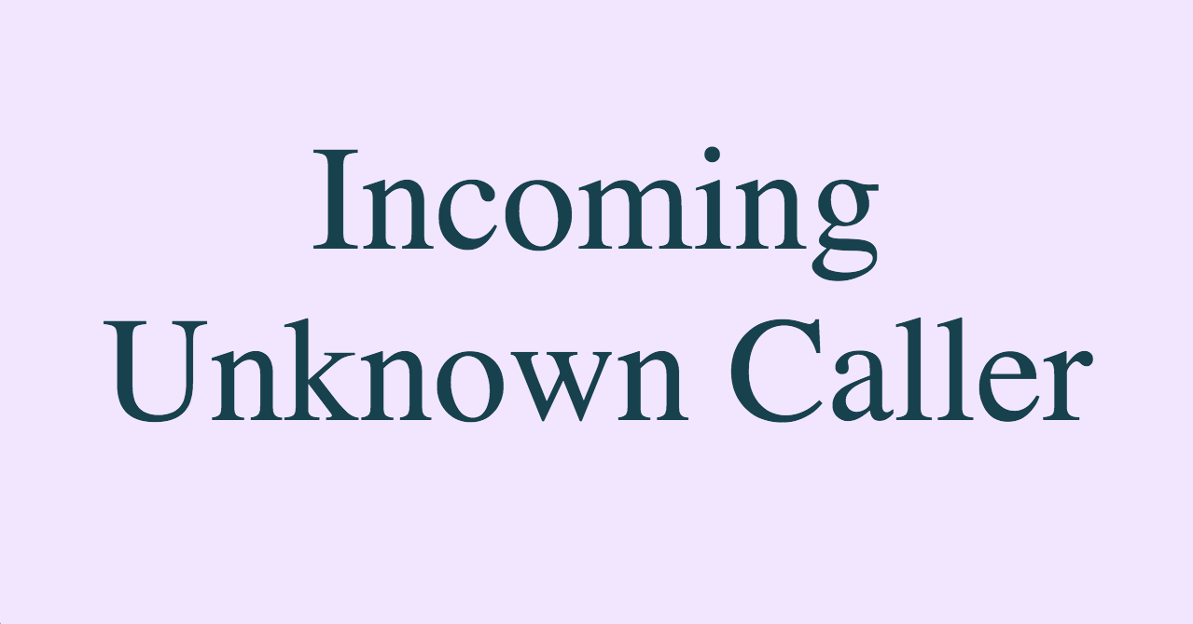
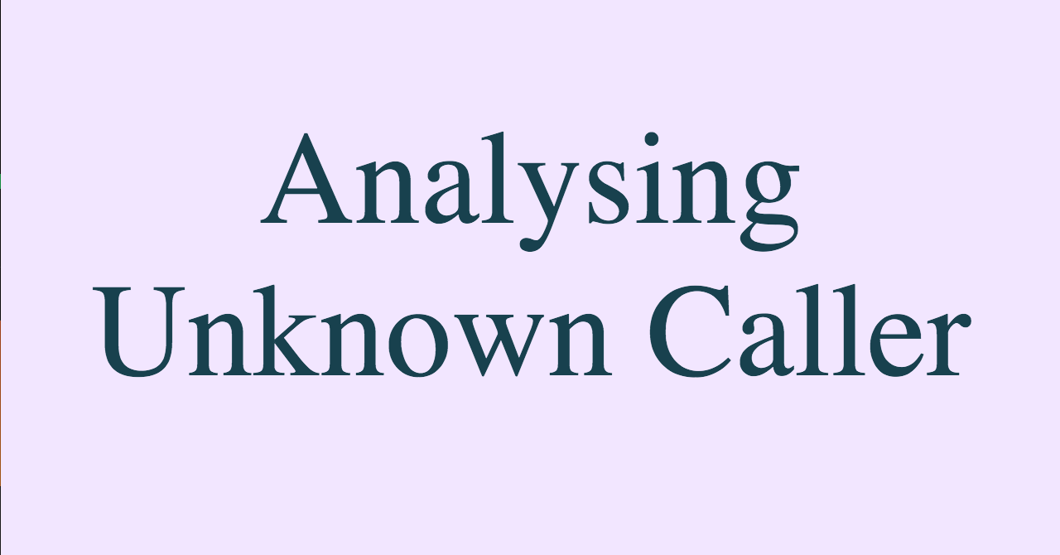
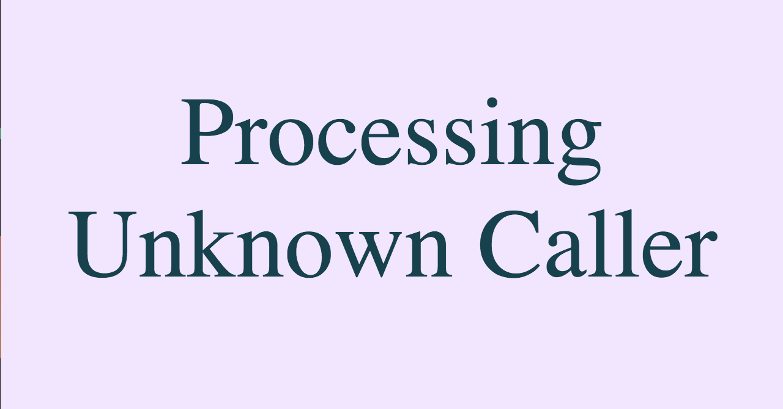

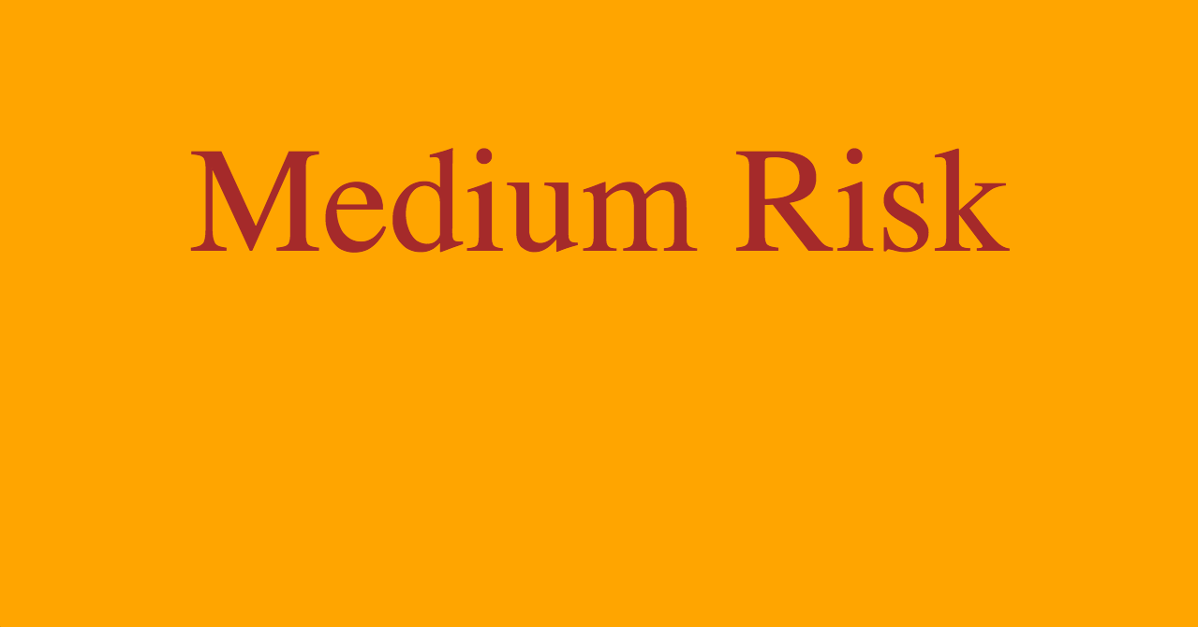



Slide 14
Testing and Results
Functionality achieved
User Interface, Ease of Caller: Survey
Everyone understood the display
Everyone understood the audio
Discourages people from calling
Robustness through the transcripts
Generally robust, more sensitive to low-medium, rather than medium-high

Slide 15
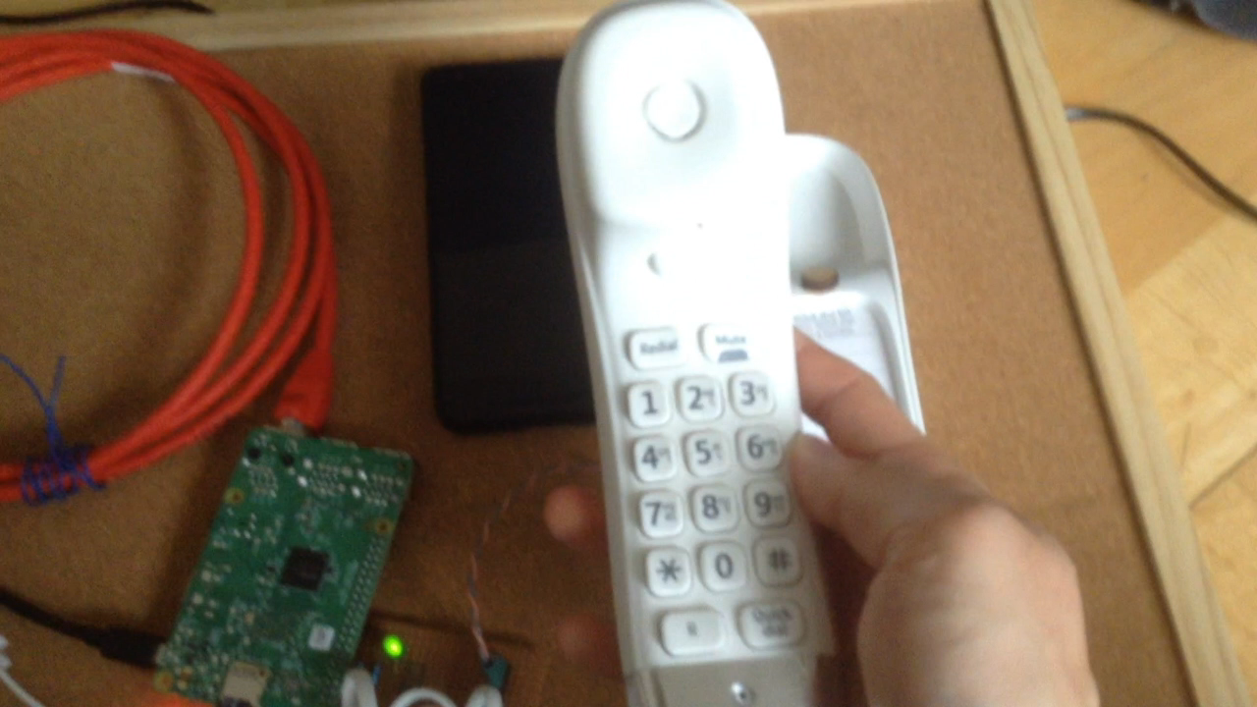
Demo

Slide 16


Conclusion

Slide 17
Questions?

Slide 18
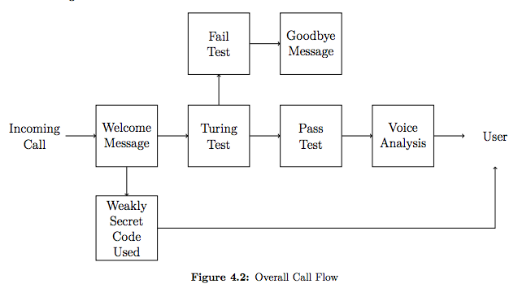
Design – Call Flow

Slide 19
Evaluation
Commercially available products?
Caller ID
Power consumption
Dynamic nature of scams!
Origin, types, audience.
Missing bypass for power outages and emergencies
Too long to get to caller!
Not fully self-contained
Non-technical methods
Option for more involved speech analysis
Cost
Machine feels weird

Slide 20
Design
Aims
Fits into existing setup
Self-contained
Without input
Simple for a genuine caller
Landline Interface
56K
Own board
SPA3012
ObiHai Obi110
Core System
Asterisk
Pi
FreePBX GUI

Slide 21

Existing SOLUTIONS?
TPS, BT Call Protect, BT’s phone, Nomorobo, Hiya.
Hobby projects
56K Modem [Chris Murphy, 17]
Academic research
Clustering audio signature
Statistical analysis
Charting call patterns
http://images.clipartpanda.com/idea-light-bulb-clip-art-black-and-white-MTLEnkBTa.jpeg

Slide 22
FUNCTION FLOW
Known Caller or Outbound
Call ends
Call in progress
Yes
Start
Phone Lifted?
New Call?
Yes
Wait for Pickup
Extract Data & Analyse
No
Yes
No
Back to Start
Display Risk
Timeout
Call in progress
Call ends

